Slide 1
Number Systems
Lecture 1

Slide 2
INTRODUCTION
Humas are familiar with the decimal number system (Base 10). Some other number systems that we will work with are:
    Binary (Base 2)
      Eg: Digital Machines(Transistors)
    Hexadecimal (Base 16)
      Eg: Conjunction with Programmable Logic Devices
  Octal number System (Base 8)
  Note: Do not ignore to write the base of the relevant number systems except for decimal numbers

Slide 3
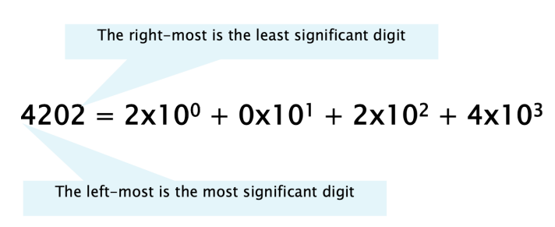
Positional Notations
A decimal number can be expressed in the following term:

Slide 4
Binary Number System
AKA “Base 2 System”
The binary number system is used to model the series of electrical signal computer use to represent information.
0 represents the no voltage or an off state.
1 represents the presence of voltage or on state

Slide 5
Binary to Decimal Conversion
The easiest method for converting a binary number to its decimal equivalent is to use the Multiplication Algorithm.
Multiply the binary digits by increasing powers of two, starting from the right.
Then, to find the decimal number equivalent, sum those products

Slide 6
Your Turn!
Convert the following binary numbers to their decimal equivalents
    0111002
    1010102

Slide 7
Decimal to Binary Conversion
The easiest method for converting a decimal number to its binary equivalent is to use the Division Algorithm.
This method repeatedly divides a decimal number by 2 and records the quotient and reminder.
The remainder digits ( a sequence of zeros and ones) form the binary equivalent in least significant to most significant sequence.

Slide 8
Your Turn!
Convert the following decimal numbers to their binary equivalents
  46
  84

Slide 9
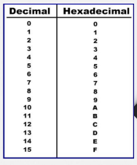
Hexadecimal Number System
Base 16 system
Use Digits 0-9 & letters A,B,C,D,E,F

Slide 10
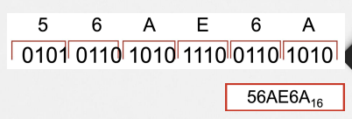
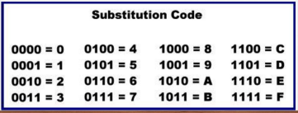
Binary to Hexadecimal Conversion
The easiest way to convert binary to hexadecimal is to use the bits substitution code.

Slide 11
Your Turn!
Convert the following binary numbers to their hexadecimal equivalents
    1100 1010 0101 0111
    2. 11 1111 0001 0110 1001

Slide 12
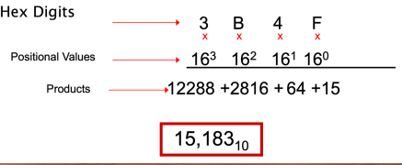
Hexadecimal to Decimal Conversion
Convert 3B4F1616 to its decimal equivalent

Slide 13
Your Turn!
Convert the following hexadecimal numbers to their decimal equivalents
1. 3BF16
2. 2D116

Slide 14
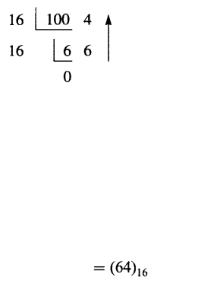
Decimal to Hexadecimal Conversion

Slide 15
Your Turn!
Convert the following decimal numbers to their hexadecimal equivalents
1. 278
2. 86

Slide 16
Self Study!
Octal Number System
What are the digits in the octal number system?
Decimal to Octal Conversion
Binary to Octal Conversion
Octal to Binary Conversion
Octal to Decimal Conversion

Slide 17
Summary
Students should be able to,
Understand the numerical system.
Explain why computer designers chose to use the binary system for representing information in computers.
Explain different number systems.
Translate numbers between number systems.

Slide 18
END OF LECTURE
Next Lecture – Computer Arithmetic

